Slide 1
Kotlin Multiplatform
Nicola Ursino - Gabriel Rovesti
19th March 2024
Mobile Programming and Multimedia
2023-2024

Slide 2
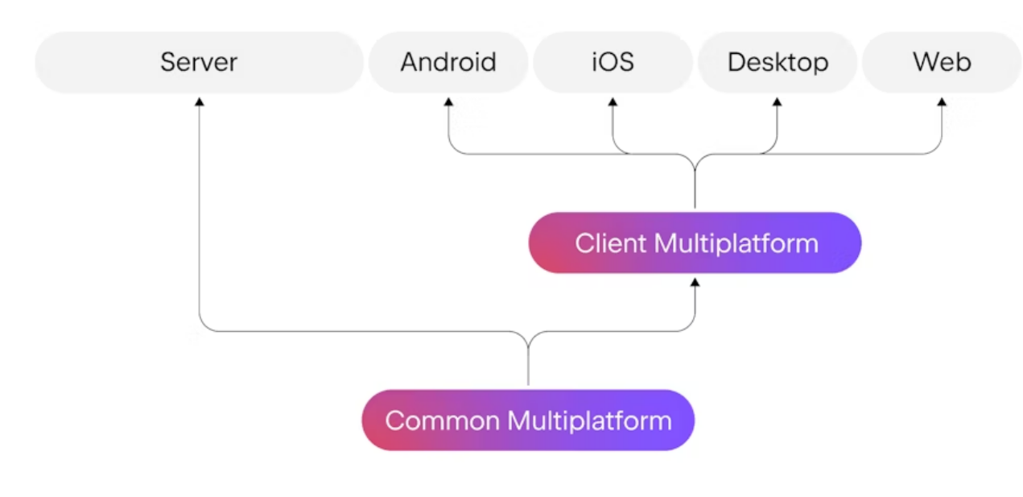
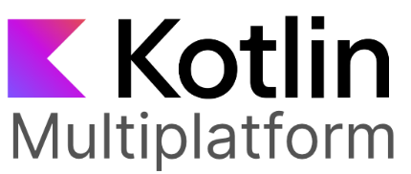
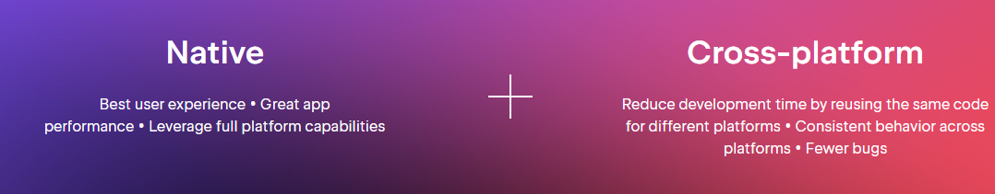
What is it about?
https://www.jacobras.nl/2023/07/popular-apps-kotlin-multiplatform-kmp-2023/
https://kotlinlang.org/docs/multiplatform.html
https://www.jetbrains.com/kotlin-multiplatform/

Slide 3
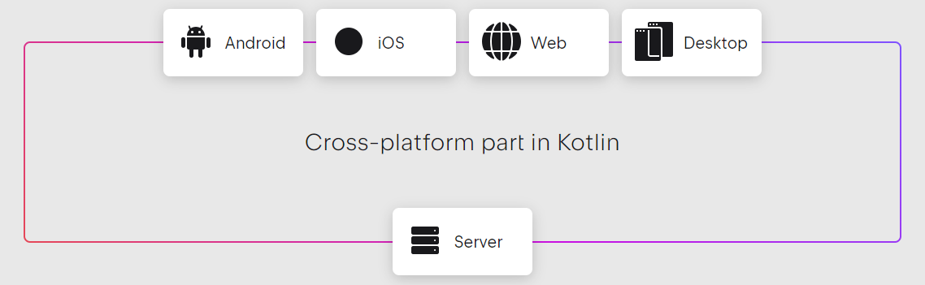
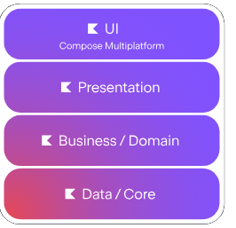
Why to choose it?
https://www.jetbrains.com/kotlin-multiplatform/
https://kotlinlang.org/docs/multiplatform.html
Pros
Native look and feel
for both Android and iOS
Shared UI codebase between all platforms in desktop and mobile
Easier learning curve thanks to Kotlin
Interoperability with other languages (e.g., Swift)
Cons
Slower in compile time for iOS
Passing from Objective-C to Swift
Limited community and docs
More development resources needed
Devs have to learn two languages for UIs
Compose Multiplatform and Kotlin

Slide 4
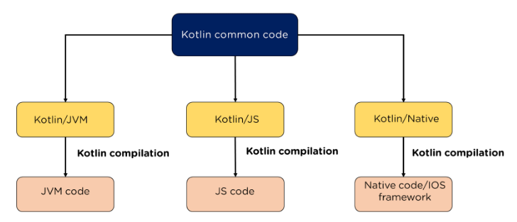
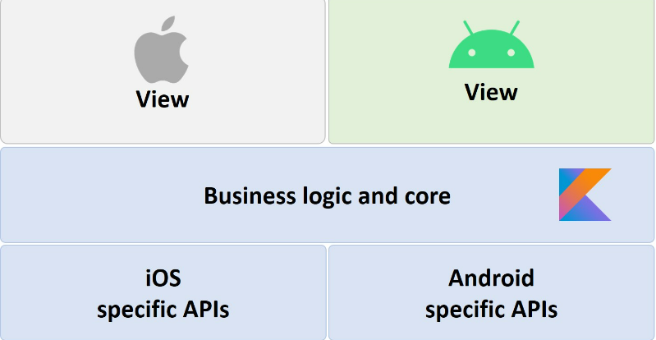
How is it classified?
https://www.simplilearn.com/tutorials/kotlin-tutorial/all-you-need-to-know-about-kotlin-multiplatform
https://blog.worldline.tech/2022/01/26/kotlin_multiplatform.html
Cross-compiled approach
The produced applications are native
Hardware/software accessed natively for both iOS and Android
Reuse of code by cross-compilation to different platforms
Logic handled by Kotlin
Choice between using Swift or Compose Multiplatform to handle UI on iOS

Slide 5
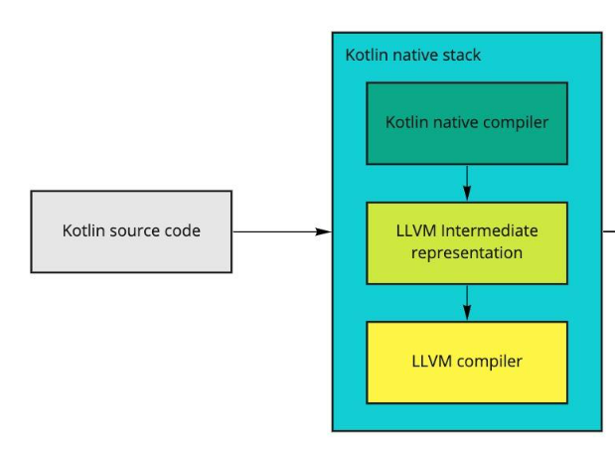
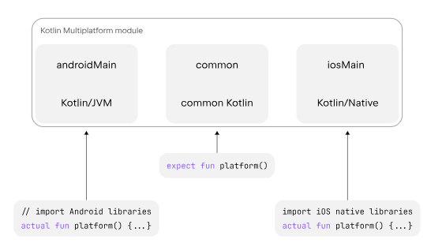
How is it classified?
https://blog.worldline.tech/2022/01/26/kotlin_multiplatform.html
https://www.jetbrains.com/help/kotlin-multiplatform-dev/multiplatform-connect-to-apis.html
Cross-compiled approach
Kotlin will be compiled for the iOS virtual machine (LLVM)
The bridge allows for native compilation/collaboration between iOS and Android
This allows for Objective-C and Kotlin to call each other’s code directly
That’s the main reason on why the compile time is slower
Compose Multiplatform allows to reuse UI without having this slowdown

Slide 6
Thanks for your attention!
Questions?
Bibliography:
https://blog.jetbrains.com/kotlin/2023/07/update-on-the-name-of-kotlin-multiplatform/
https://www.jetbrains.com/lp/compose-multiplatform/
https://www.simplilearn.com/tutorials/kotlin-tutorial/all-you-need-to-know-about-kotlin-multiplatform
https://www.netguru.com/blog/kotlin-multiplatform-pros-and-cons
https://www.jacobras.nl/2023/07/popular-apps-kotlin-multiplatform-kmp-2023/
https://blog.worldline.tech/2022/01/26/kotlin_multiplatform.html
https://medium.com/ymedialabs-innovation/kmm-whats-under-the-hood-1a26cb50ca67
https://www.linkedin.com/pulse/flutter-vs-kotlin-multi-platform-2023-guide-maharshi-saparia/
https://dev.to/y9vad9/kotlin-multiplatform-is-now-stable-whats-the-impact-4f18
https://betterprogramming.pub/opinionated-view-on-kmm-6726444dcae1
https://github.com/kotlin-hands-on/kotlin-swift-interopedia
https://www.miquido.com/blog/is-kotlin-multiplatform-the-future/

